Slide 1
Clustering Analysis on Banknote Authentication Data

Slide 2
Objective:
The goal of this project is to apply unsupervised machine learning (KMeans Clustering) on the Banknote Authentication dataset to discover latent patterns in the data. This approach is beneficial in scenarios where labeled data is scarce or unavailable, enabling institutions to detect counterfeit banknotes without relying on known labels.
Use Cases:
Fraud detection in financial systems
Early-stage clustering of novel/unseen transactions
Feature engineering for advanced authentication models

Slide 3
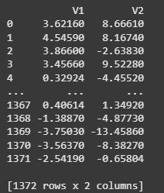
Dataset Summary: Source: UCI Banknote Authentication Dataset Features Used: V1: Continuous numeric feature (likely derived from wavelet transformation) V2: Second such numeric feature Size: 1,372 records, 2 features Preprocessing: No missing values; no label column used since clustering is unsupervised

Slide 4
Analysis Methods
Approach Used:
✔ KMeans Clustering (from sklearn.cluster)
✔ Unsupervised learning to group data into two clusters (n_clusters = 2)
Steps Followed:
Loaded CSV into a Pandas DataFrame
Applied KMeans on two features: V1 and V2
Appended cluster labels (0 or 1) to a new column
Computed descriptive statistics for each feature and cluster

Slide 5
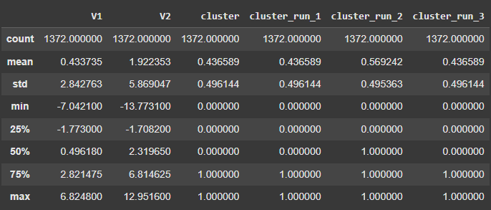
Descriptive Stats (aggregated):

Slide 6
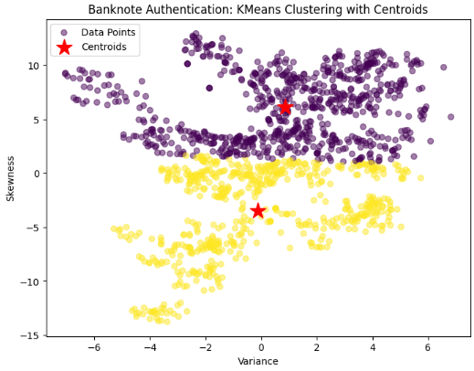
Banknote Authentication: KMeans Clustering with Centroids

Slide 7
Summary of Results
KMeans successfully partitioned the data into two clearly defined clusters.
Distinct clusters imply natural grouping — which may correspond to genuine vs. forged notes.
V1 and V2 exhibit significantly different distributions across clusters, supporting use in authentication workflows.

